Slide 1

HealthX- Healthcare App
Prithvi Shetty 21
Shitaanshu Singh 22
Nishit Thakkar 23
Nelkin Eldho 24
Date of the presentation:18/10/21
Under the guidance of: Ms. ALVINA ALPHONSO
St. Francis Institute of Technology
Department of Information Technology

Slide 2

Contents
Introduction
Review of Literature
Need for the application
Problem Definition
Project Objectives
Proposed Solution
Scope of Project
System Description
Hardware & Software Requirements
User Interface Design (GUI snapshots)
Implementation Screenshots
Conclusion
References

Slide 3
Introduction
People often tend to forget to take medication on time.
Taking medication is occasionally frustrating, but ultimately necessary.
For this purpose we have proposed to develop an app which can make the experience a little easier.
In our proposed app one needs to input one’s pills, how often one needs to take them, and one’s pill schedule. From there, the apps remind one to take pill at the proper time. The user can also search for nearby Hospitals and medical stores via the application.

Slide 4
Review of Literature
Sr.no | Title of the Paper | Review | Analysis
1 | An android based medication reminder system based on OCR using ANN. | The system sets the reminder in the built in calendar application of the app. The reminder reminds the person of his/her medicine in take schedule. | The System gives reliable results for reminding the user although it uses complicated functions od OCR and ANN.

Slide 5
Review of Literature
Sr.no | Title of the Paper | Review | Analysis
2 | Medication reminder and healthcare android application. | The patients will get the schedule of medicine in-take time with medicine description, starting and ending date of medicine. The patients can also search doctors disease wise easy searching facility to the users and saves the time. | The application gives reliable reminders, good user interface, nice user experience and it supports many new features supporting medication adherence.

Slide 6
Review of Literature
Sr.no | Title of the Paper | Review | Analysis
3 | Android Application for Emergency Medical Assistance (Doctors Nearby). | This project represents a solution that will be useful in emergencies. The situations may include accidents, natural or human-made calamities. The android app has facilities such as storing user details and the contacts of the receiver in emergencies. | In case of emergency when the user presses the “emergency button” present in the application, a list of nearby hospitals and clinics are displayed on the screen of the cell phone, using this information the user can select the desired hospitals or clinic and the routes.

Slide 7
Research Gap
[1] need to improve the accuracy of character recognition. There should be facility of adding names & dose of medicine should be included in the reminder.
[2] overall performance of the system should be improved, user interface isn’t user friendly.
[3] no reminder for medicines.

Slide 8
Need for the application
It is a native android application meant to aid the forgetful and busy with remembering to take their daily medications.
Designed for users for keeping track of their medication schedule.
The application would allow the user to store pill objects and multiple reminders for those pills.
The Application will locate the list of nearby medical shops.
The Application would provide health tips and first aid tips.

Slide 9
Problem Definition
The application will be developed to notify the user when to take his/her medicine at a scheduled time and will also provide the user nearby medical stores location along with some first aid and heath tips.

Slide 10
Project Objectives
Remind user to take his/her medicine on time.
Help user keep track of what medicine he/she takes.
Get the location of nearby Hospitals and medical stores.
Provide user with some emergency first aid tips.
Displays some important health tips.

Slide 11
Proposed Solution
The User will enter the details of medication according to his/her prescription into the application.
The Application will notify or alert the user according to the time and date of medication.
The user can also locate the medical stores to stock up their medicines.
The Application would provide health tips and first aid tips.
The proposed app would be developed on android because android has a larger market share.

Slide 12
Scope of the Project
The application has been designed in such a way that it would be easy to use by majority of the users.
The users will be able to enter personal and prescribed medicines in the application.
The users will be reminded of their medications at correct time.
The user would be provided with health and first aid tips.

Slide 13
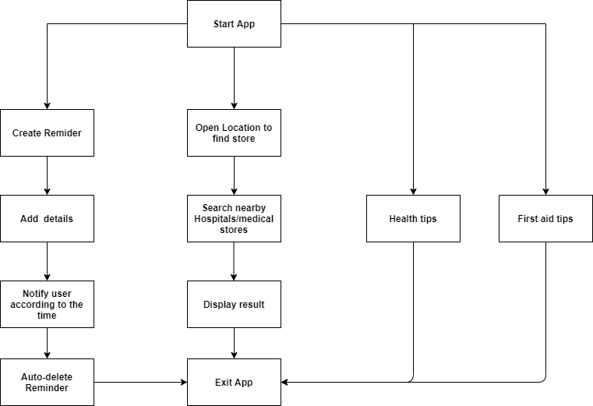
System Description

Slide 14
Hardware & Software Requirements
Software requirements –
Android Studio Version 4.2.2
Operating System Window 7,8,10.
Hardware requirements –
Minimum 8 GB RAM.
Intel processor minimum Intel i5 or Amd Ryzen 3.
Internet connection Minimum 50 Kbps.

Slide 15
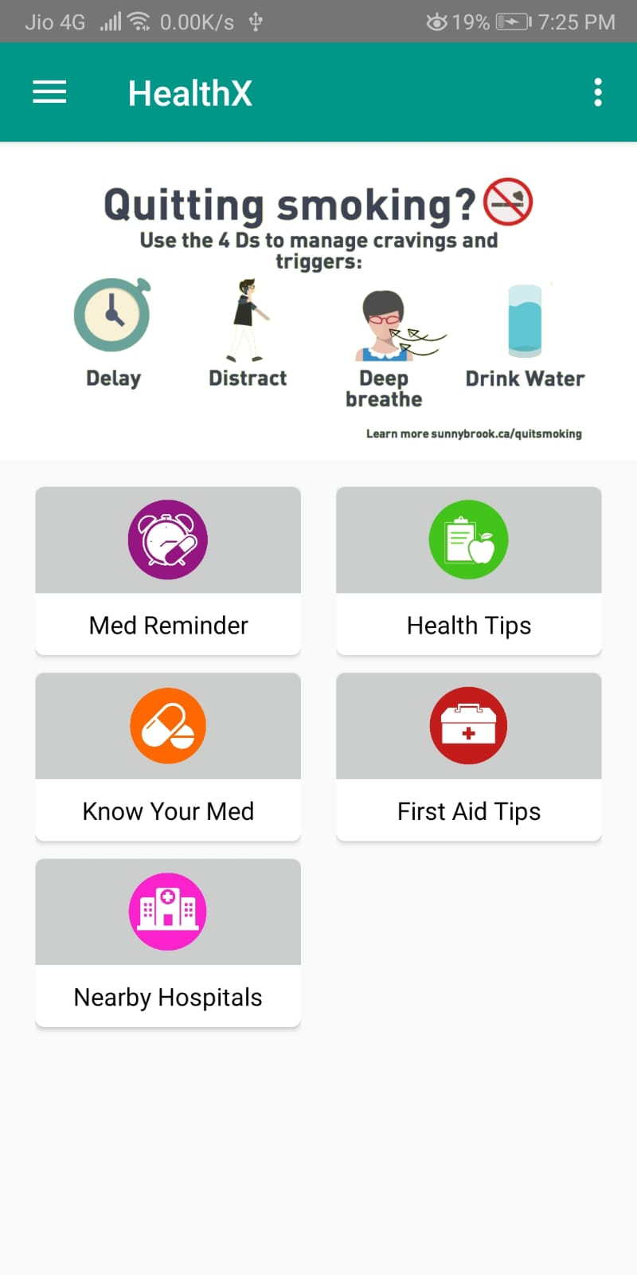
User Interface Design (GUI snapshots)

Slide 16
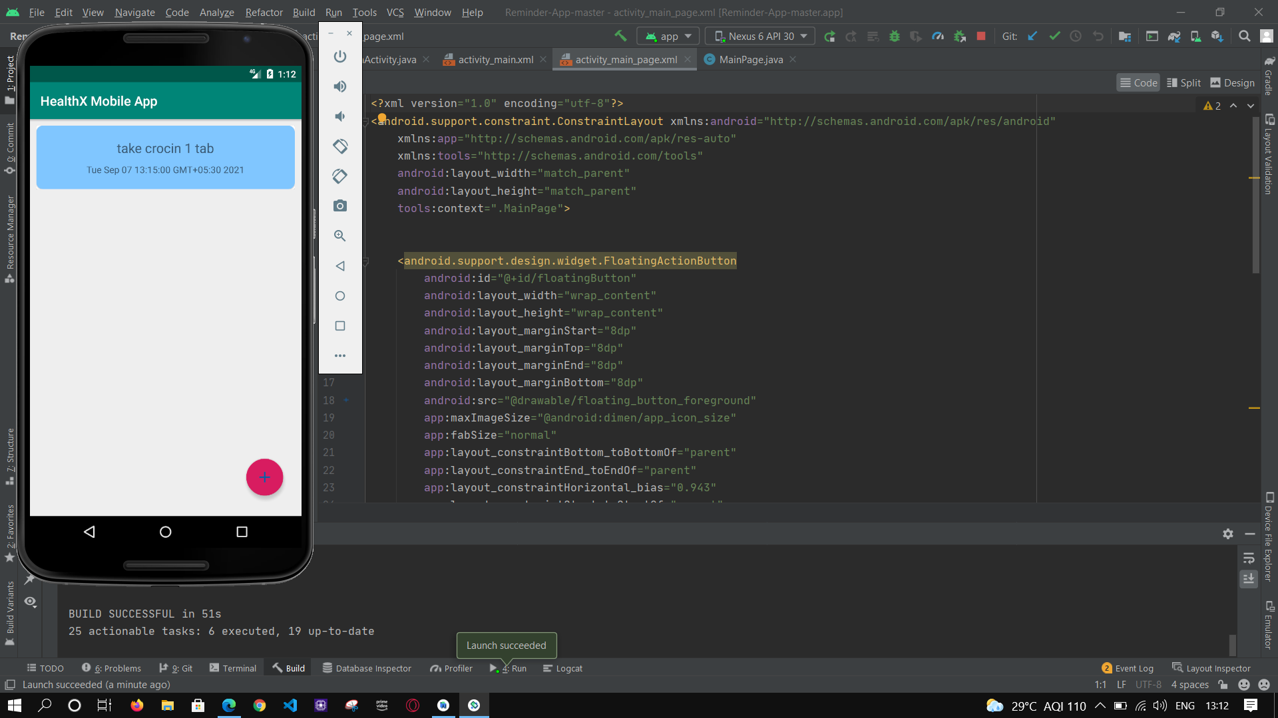
Implementation Screenshots

Slide 17
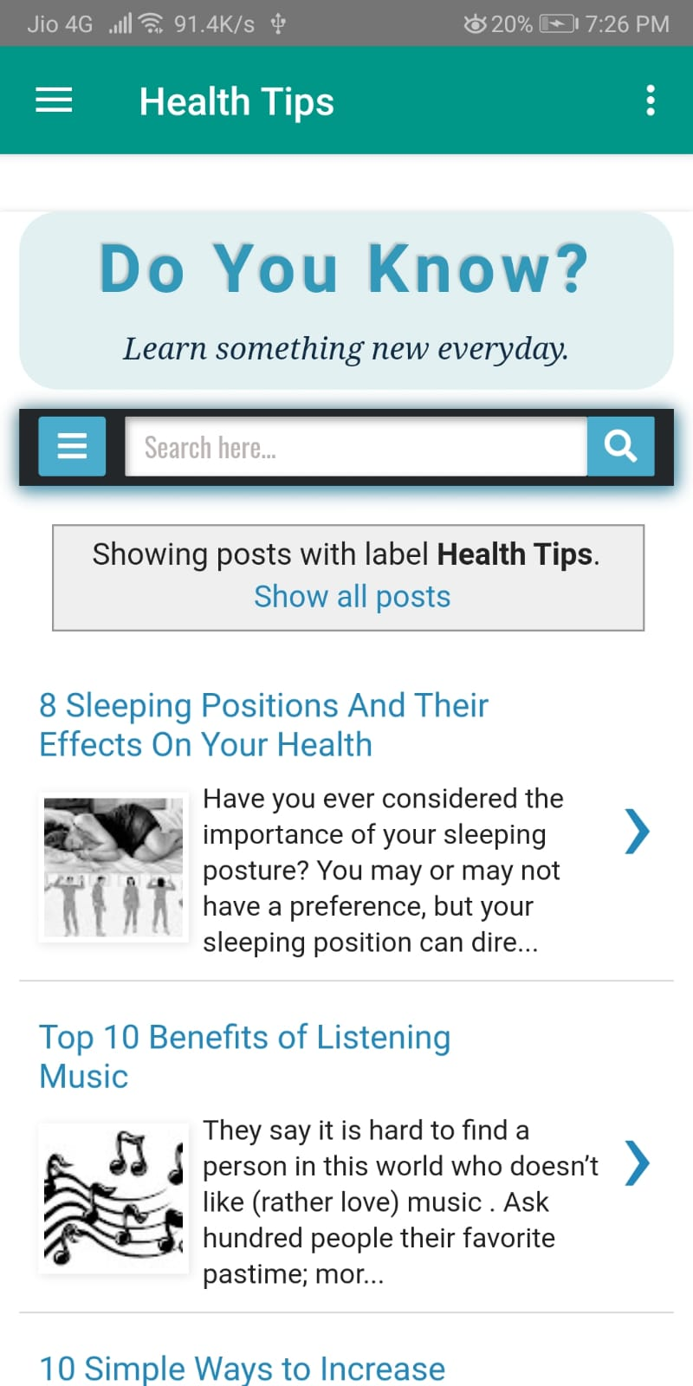
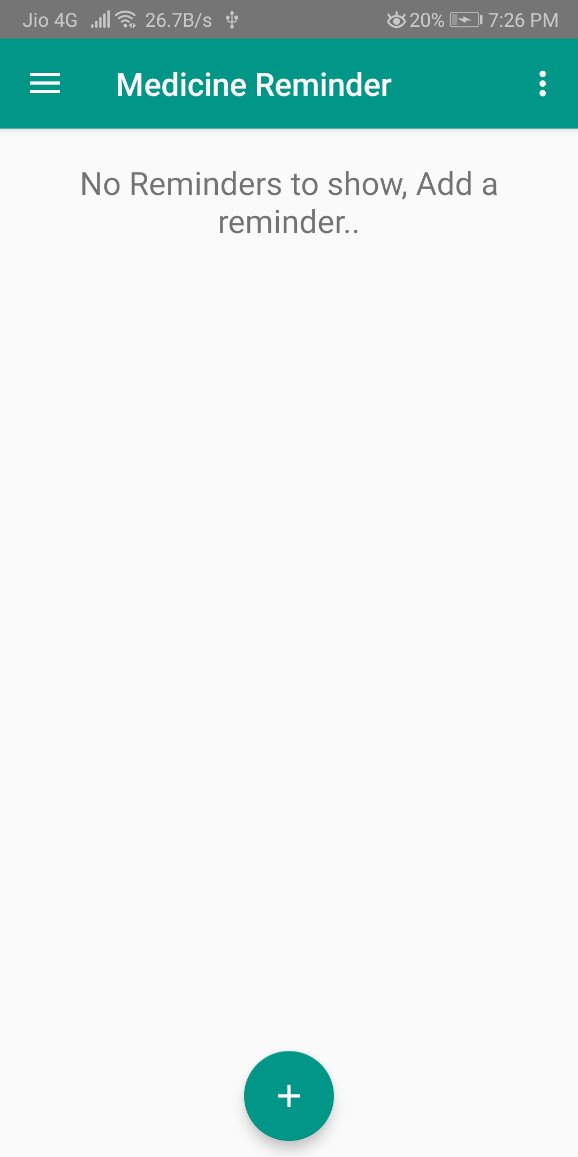
Implementation Screenshots

Slide 18
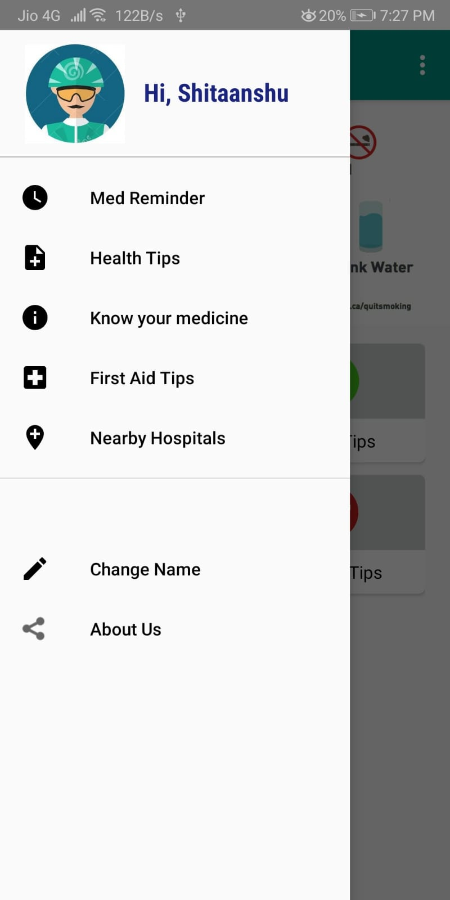
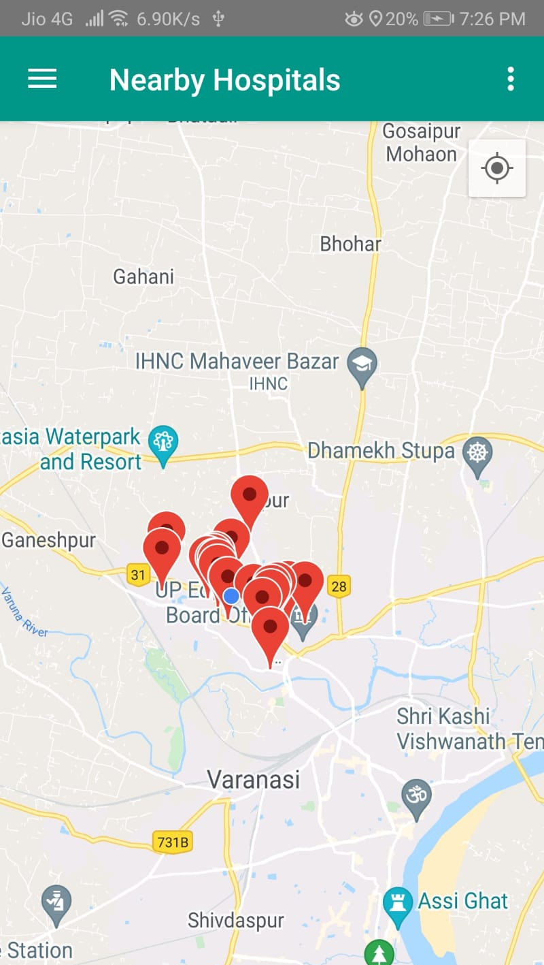
Implementation Screenshots

Slide 19
Conclusion
We have proposed HealthX- Healthcare app. The main advantages of this application is that it notifies the individual to take his/her medication and provides health and emergency first aid tips. It also provides location of nearby Hospitals and medical stores. This app would be useful to individuals who forget to take their medicines on time.

Slide 20
References
[1] Bhadane ashwini, Kale sapna, Bhuse Ishwari, Pawar Pallavi, p.n. Achaliya,”An Android Based Medication Reminder System Based on OCR Using ANN". International conference on recent Trends in engineering & technology(ICRTET)2013.
[2] Deepti Ameta, Kalpana Mudaliar , Palak Patel, “Medication Reminder And Healthcare- An Android Application". International Journal of Managing Public Sector And Communication Technologies (IJMPICT) Vol.6,No.2,June 2015.
[3] Dhanesh Sharma,Priyanka Dubey, Navin Singh, “Android Application For Emergency Medical Assistance (Doctors Nearby)”.International Journal of Scientific & Engineering Research(IJSER)2016.
[4] How To Build A Medication Notification App – (www.devteam.Space)
[5] Pill Reminder & Medication Tracker App Development Cost & Features (www.emizentech.com)

Slide 21
Questions??
Thank You!

